Slide 1


The Problem with cDonald’s
Sentiment / Topic Modeling of Online Reviews
Business Insights & Recommendations

Slide 2

The Goal
Analyze customer reviews to identify pivotal areas of dissatisfaction
Understand how bad experiences can lead to negative brand reputation
Utilize data-driven sentiment analysis and topic modeling
Provide insight and recommendation to improve customer satisfaction

Slide 3
Our Data
Kaggle Dataset - McDonald’s Store Reviews
33,000 anonymous google reviews
Various U.S. store locations
Cleaned data by:
Removing stop words
Removing additional words that were not adding more value to the sentiment analysis

Slide 4

Using Sentiment Analysis and Topic Modeling
Used customer reviews to reflect customer perception.
Performed topic modeling to find recurring themes and topics, indicating “positive” or “negative” trends.
Conducted sentiment analysis to determine which direction most customer reviews were leaning.
Analyzed sentiment to pinpoint key areas of customer dissatisfaction
Made sure to minimize redundancy, and removed unnecessary descriptors and keywords like emojis, common-stop words, e.t.c.
Modeled 10 topics with 7 words per topic
Less topics and words per topic made topics very generalized

Slide 5



The Following
The Findings
Highlights and breakdown of the data
Identifying the Problem
Models used and results
Our Approach
Recommended implementation to resolve the issues

Slide 6
The Findings

Slide 7

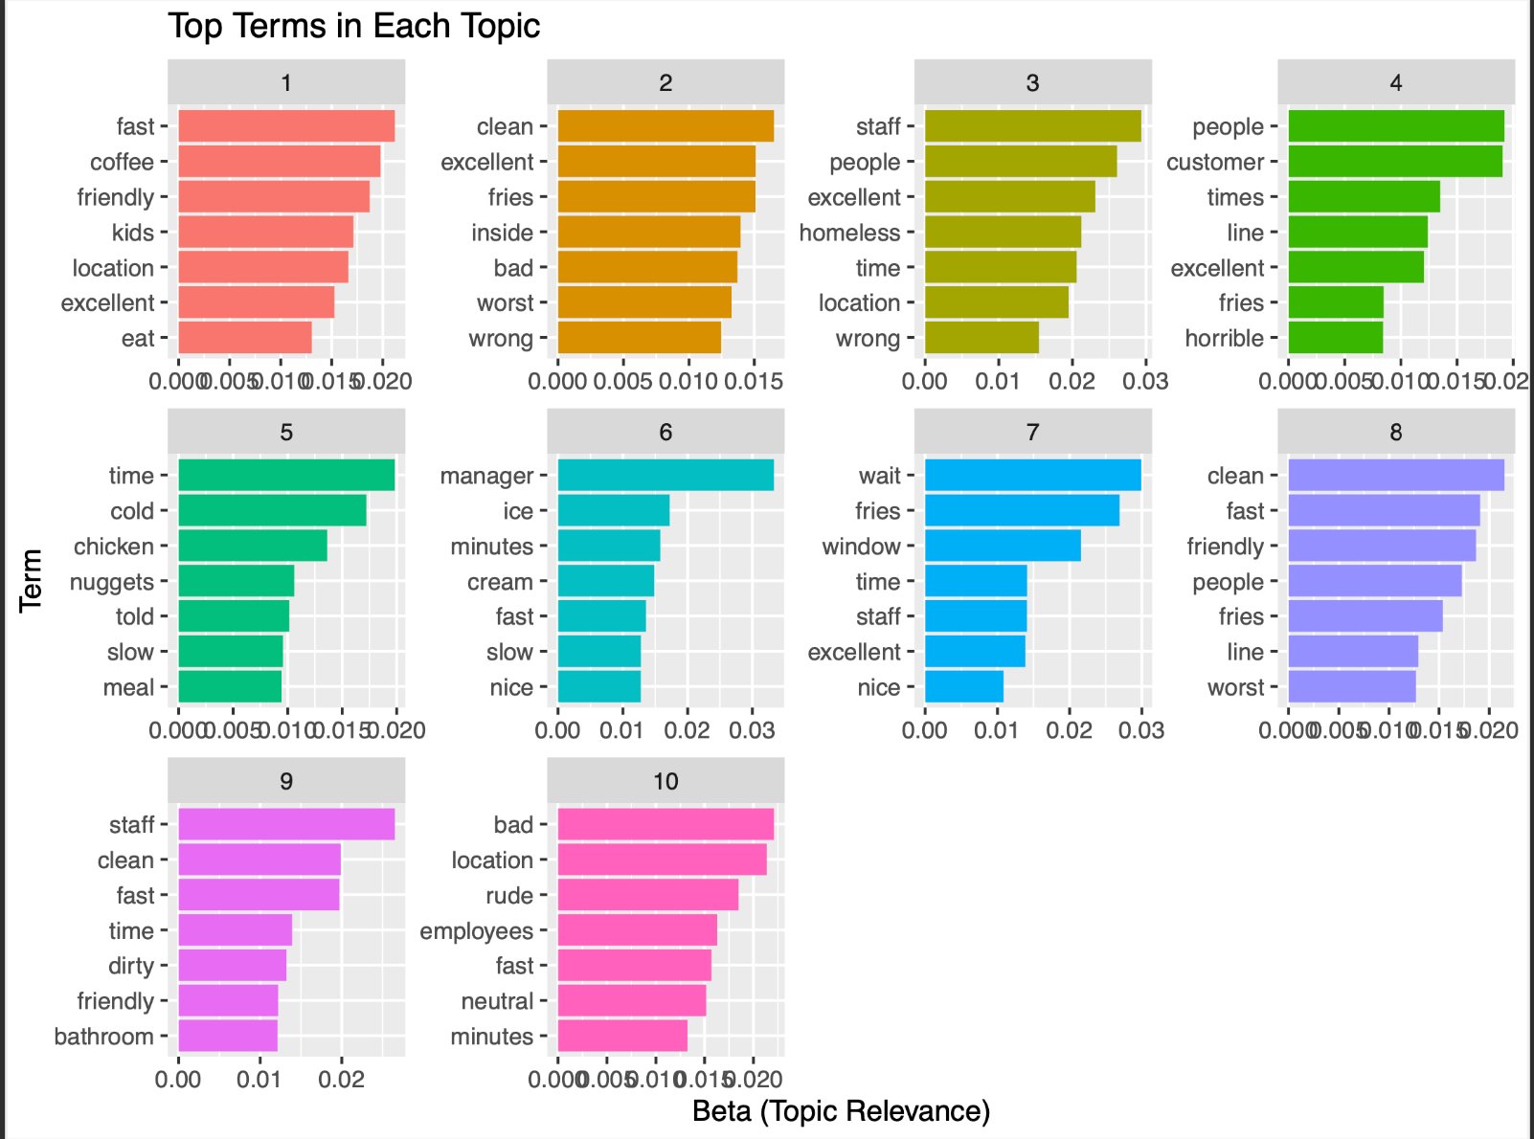

Slide 8
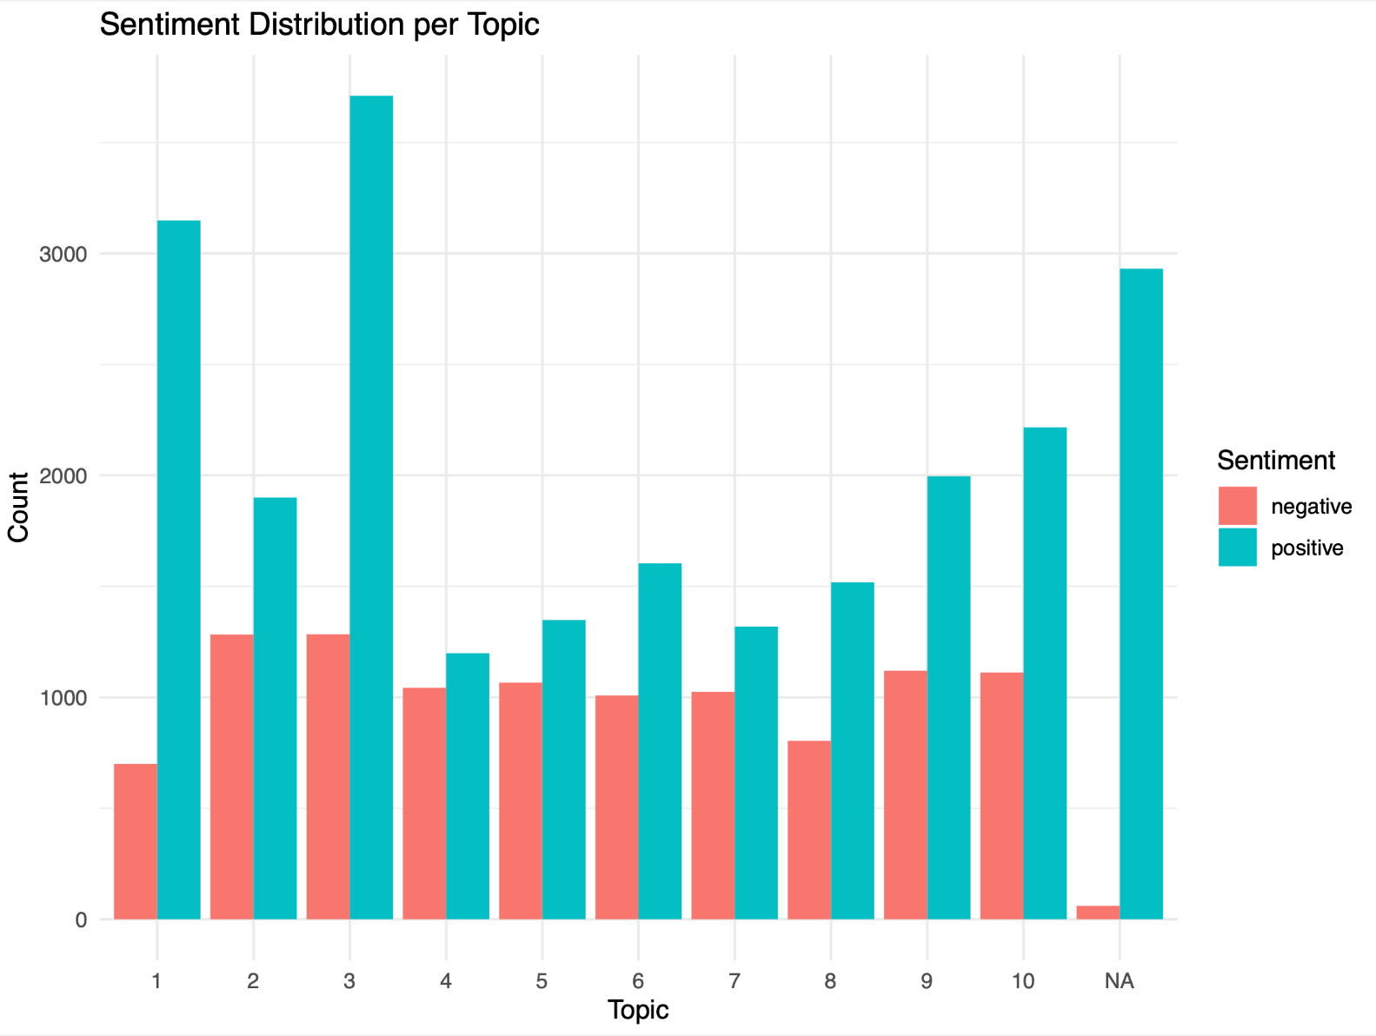

Slide 9
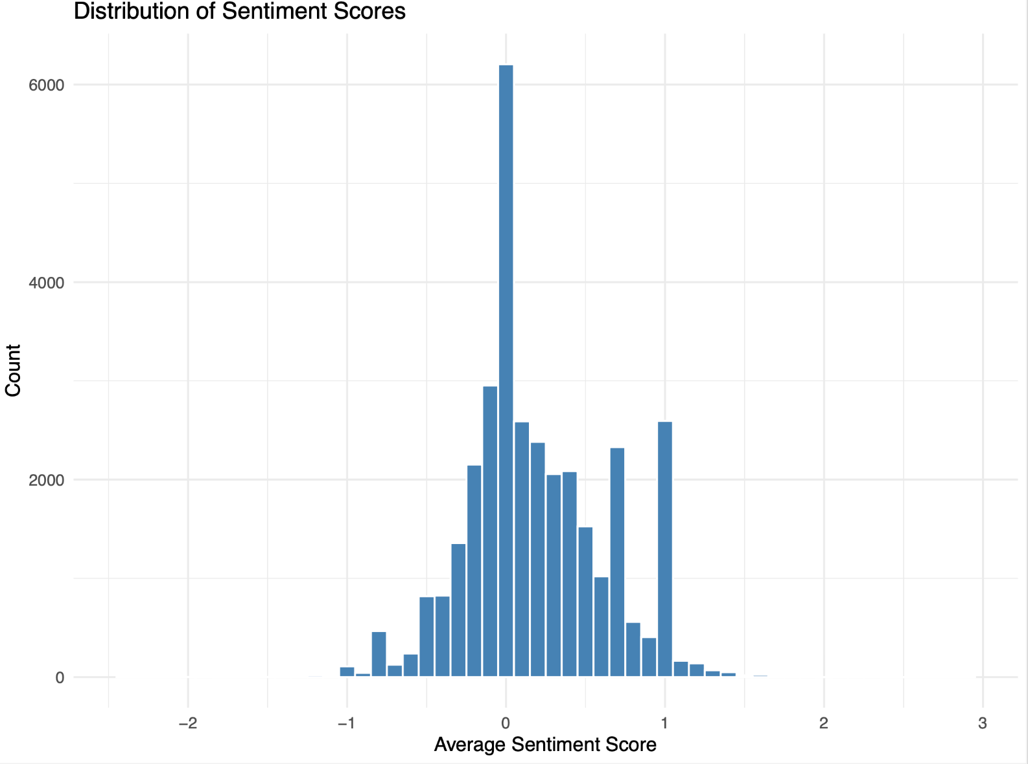

Slide 10
The Problem &
The Solution

Slide 11
Derived Topic Names and Sentiment:
Service Time & Friendliness -
Mixed (Positive-leaning)
Cleanliness & Safety -
Mixed (Negative-leaning)
Environment & Staff -
Mixed (Positive-leaning)
Wait Time - Negative
Food Quality and Wait Time-
Mixed
6. Food Quality and Manager Interaction -
Mixed
7. Drive Thru & Wait Time - Negative
8. Food Quality & Friendliness -
Positive
9. Fase Service & Staff - Positive
10. Parking & Waiting Area -
Positive

Slide 12
Impact of Negative Sentiment on McDonald’s Brand
Negative customer experiences affects customer satisfaction and perception.
Issues around wait time, store cleanliness, and manager interactions encourage customers to choose competitors.
Negative reviews tends to amplify bad perceptions about the McDonald’s Brand.
Persistent dissatisfaction leads to a decrease in customer lifetime value thus negatively impacting revenue.
Proactive measures towards battling the negative can held to rebuild trust and increase customer retention.

Slide 13
Our Proposed Solution
Negative Topics and Words:
Slow service/ long wait → “wait”, “slow” “minutes”, “line”, “waiting”
Manager/staff issues → “manager”, “rude”, “told”, “bad”, “people”
Cleanliness/safety concerns → “dirty”, “homeless”, “location”, “clean” (Negative leaning)
Parking/Drive-thru congestion → “lot”, “waiting”, “window”, “minutes”
Recommendation:
In order to resolve negative customer experiences surrounding wait times, managers should increase staffing during peak hours and further streamline order processing.
In order to handle manager and staff service issues, McDonald’s locations should implement training programs that emphasize conflict resolution skills and customer service etiquette.
Carry out more frequent lobby and parking lot inspections to prioritize store cleanliness.
Implement Customer Recovery Programs to train managers to quickly resolve negative customer experiences with goodwill gestures like a coupon or a free item.

Slide 14

Conclusion
There is an overall positive sentiment around the McDonald’s brand.
The goal is to combat any negative interactions as it amplifies negativity towards the McDonald’s brand.
Negative sentiment found in the sentiment analysis/topic modeling had to do mainly with wait times, manager/staff service, and store cleanliness.
Implementation of staff training programs to enhance customer service and conflict resolution would aid in reducing negative reviews and sentiment.
Increased staffing during peak hours could potentially help in decreasing wait times leading to increased customer satisfaction.

